Slide 1
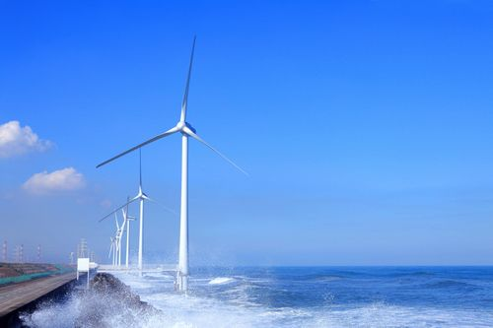
Offshore Wind Power Development in Japan
For WindEurope2022 at Bilbao,
April 2022
Mr. Yoshinori UEDA
General Manager, Communication
Japan Wind Power Association (JWPA)
Wind Power Kamisu, in Ibaraki pref.
2MW x 15units = 30MW,
Starts operation in 2010&2013.

Slide 2
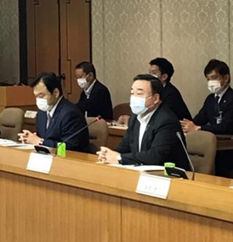
The meeting of Council for Public-Private Dialogue for Offshore Wind (Jul.&Dec. 2020, Tokyo) 1st Mtg.: http://jwpa.jp/page_298_englishsite/jwpa/detail_e.html 2nd Mtg.: http://jwpa.jp/page_301_englishsite/jwpa/detail_e.html
Organized by METI & MLIT. Representatives of Japanese big companies also attended
METI : Ministry of Economy, Trade and Industry
MLIT : Ministry of Land, Infrastructure, Transport and Tourism
The voice of wind energy industries is scooped up.
Similar concept to Sector Deal Ministers of MLIT and METI
in UK and Poland.
The 1st meeting : on 17 July 2020
The 2nd meeting : on 15 Dec. 2020
“Offshore Wind Power Industrial
Vision (1st)” was adopted at the
2nd meeting.

Slide 3
“Offshore Wind Power Industrial Vision（1st）” https://www.meti.go.jp/shingikai/energy_environment/yojo_furyoku/pdf/002_02_e02_01.pdf
1. Creation of an attractive domestic market
(Official ambitious target announcement by Japanese government)
- 10 GW by 2030
- 30 GW to 45 GW by 2040
Note: All above targets shall be counted based on approved projects under the so-called FIT law.
At least 30 GW is available by fixed-bottom type.
2. Target set by the industry initiative
(Promoting investment and raising up domestic supply chain)
- Japan content : 60% by 2040
- Cost Reduction : 8 to 9 JPY/kWh (60 to 66 €/MWh)
by 2030 to 2035 (Net Generation Cost)
Note: All above targets shall be counted based on approved projects under the so-called FIT law.
3. Next-generation technology development
with a view to expansion into Asia

Slide 4
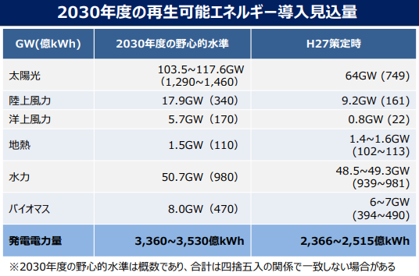
Japanese 6th Energy Master Plan has announced in Oct. 2021
Solar
Onshore Wind
Offshore Wind
Geothermal
Hydro
Biomass
Generation
(100 Mil. kWh)
Note: 5.7GW of offshore wind power is in operation by 2030.
More 1 or 2GW may be added by government & industry efforts.
“10GW by 2030” at “Offshore Wind Power Industrial Vision” is “Approval base”.

Slide 5
Laws and Tariff at Offshore Wind Power in Japan Japanese sea area is divided into several categories by Japanese law system.
Sea Area Categories |  | Law | Occupation year | Auction Organizer | Tariff
 |  |  |  |  | FY2021 | FY2022 | FY2022
Territorial Sea (Within 22.4 km From Seashore) | Port Sea Area | Harbor & Port Law (Amended in 2016 & 2019) | 30 years | Prefectural Government | FIT 36 JPY/kWh （265 €/MWh） | No data | No data
 | General Sea Area (Much broader than Port Associated Sea Area) | New offshore law (Enforced in April 2019) | 30 years | Central Government （free) | Fixed Bottom : Auction (Up to 29 JPY/kWh, 214 €/MWh) Floating : FIT (36 JPY/kWh, 265 €/MWh)
 |  | GOJ - ｌed Auction （may be after Round 5, FY2023) | 30 years | Central Government （Controlled)
Exclusive Economic Zone (EEZ) |  | No regulations | No data | No data | No data | No data
Researched by JWPA
- No floating projects are conducted at Port Associated Area now.
- As for Port Sea Area, auction had done for 5 areas.
- As for General Sea Area, total 23 areas are nominated for auction now.
Within 23 areas, the auction winners were announced for 4 areas by 2021 end (Round 1)..
- In July 2021, Japan’s METI chose three government-led central coordinated research projects, including Gann-u
and Minami-Shiribeshi in Hokkaido prefecture, Sakata in Yamagata prefecture Hirono in Iwate prefecture.
Wind resource measurement, seabed survey and environmental impact assessment for those three projects
will be completed by the government before the auction. Hirono project is set for floating offshore wind.
- The shift to GOJ - led system will take place after Round 5 (FY2025).

Slide 6
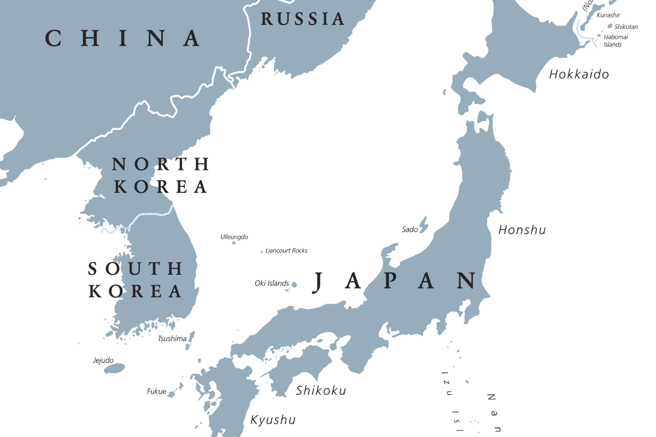
Development in Port Sea Area
Ishikari-Shinko,
In Hokkaido pref.
99 MW
Mutsu-ogawara bay,
In Aomori pref.
80 MW
Akita Port & Noshiro Port,
In Akita pref.
139 MW
Kashima port,
In Ibaraki pref.
220 MW
Hibikinada, Kitakyushu port,
In Fukuoka pref.
220MW

Slide 7
Development at Port Associated Sea Area
Project name & place | Site output & turbines | Developer | Statas
Akita Port & Noshiro Port, In Akita pref. | Vestas 4.2MW x 33 units = 139 MW, Monopile foundation | Marubeni | Waiting for rotor & racelle assembly. Start operation by 2022 end.
Hibikinada, Kitakyushu port, In Fukuoka pref. | Vestas 9.5MW x 25 units = 220 MW Jacket foundation | Kyuden Mirai (Subsidiary of Kyushu Electric Power Co.) | Under construction
Ishikari-Shinko, In Hokkaido pref. | 8MW x 14units = 99 MW | Green Power Investment | Under Construction
Kashima port, In Ibaraki pref. | Max 180 MW | Windpower group | Waiting for construction
Mutsu-ogawara bay, In Aomori pref. | 80 MW | Kitanihon-Kaiji-Kogyou, etc. (Local company in Aomori) | Waiting for construction
Note:
Local prefectural governments conduct the auction.
All projects are “fixed-bottom type”.
They can enjoy high FIT : 36 JPY/kWh (265 €/MWh)

Slide 8
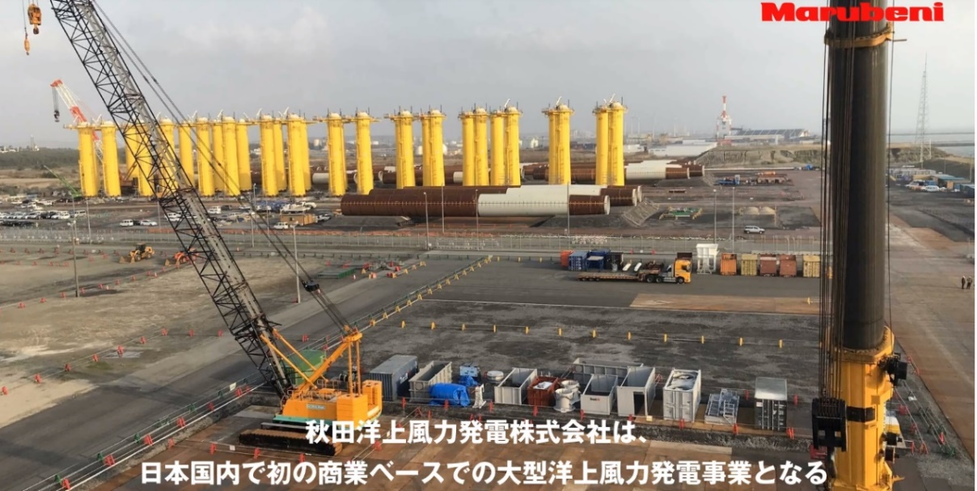
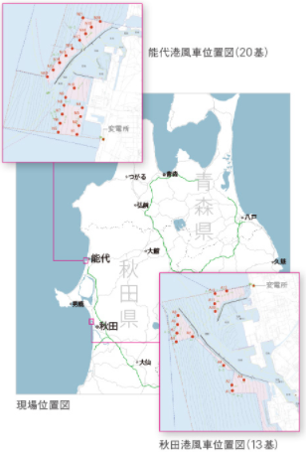
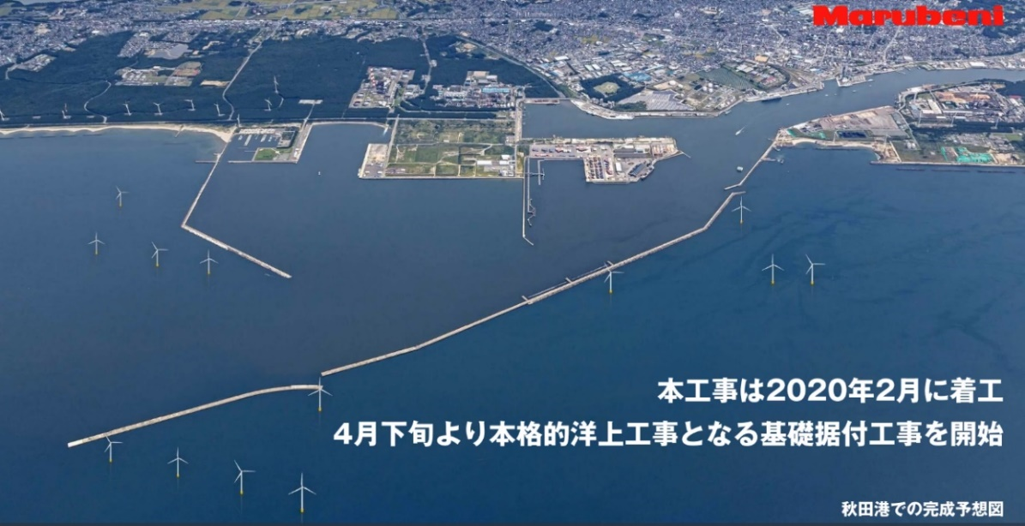
All monopile foundations are installed at Akita port (4.2MW x 13units) and Noshiro port (4.2MW x 20units) in 2021
1st local auction project for “Port Associated Area”.
Turbines will be installed in next summer and
start operation by 2022 end.
Developer : Marubeni Group
Constructor : Kajima Co. and
Sumitomo Electric Co.
Turbine : Vestas 4.2MW x 33 units
= 138.6MW
Foundation : Monopile （SIF）
Port
Associated
Sea Area

Slide 9
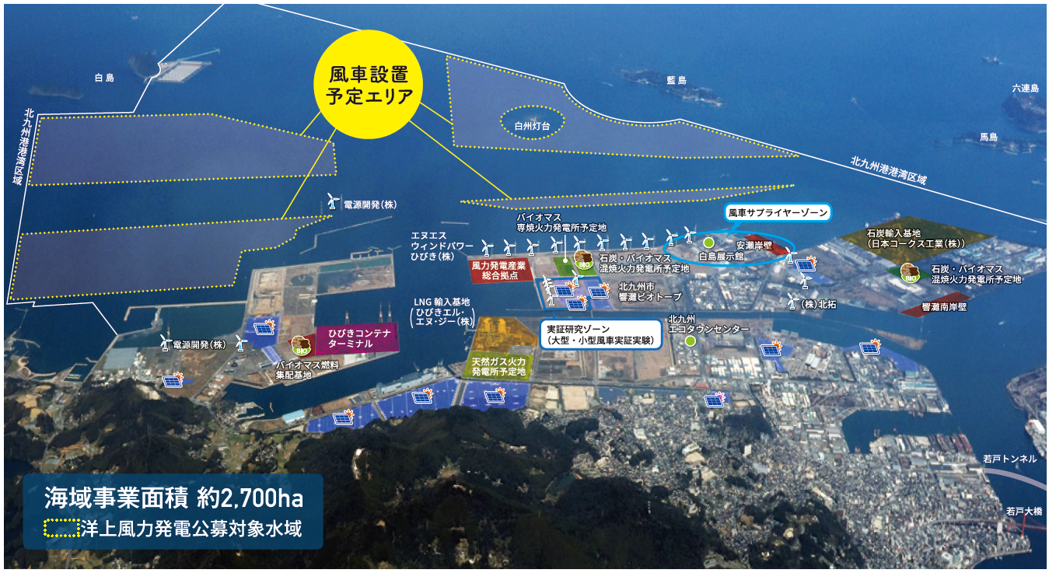
Construction starts for “Wind Power Hibiki” (220 MW) at Kitakyushu city in Fukuoka Pref. in 2022
Developer : Kyuden Mirai (subsidiary company of Kyushu Electric Power Co.), J-Power,
Hokutaku, Seibu Gas, and Kyudenko (subsidiary company of Kyushu Electric Power Co.)
Turbine : Vestas V174 9.5MW, Total 220 MW
Foundation : Jacket type （Nippon Steel Engineering）
Port
Associated
Sea Area

Slide 10
JWPA & GWEC hold Second GOWS-J
on 9-10 Nov. 2022 at Akita.

Slide 11
Japan started “Offshore Auction System“ since 2019 at General Common Sea Area
- Japanese METI and MLIT are jointly in charge of this Auction.
- Applied for “territorial sea area”, mainly for “fixed bottom type”.
(Sea depth at Japanese EEZ is too deep for fixed bottom type use.)
- Select about 1GW (about 350MW x 3-4 sites) per year until 2030.
(This introducing size will be upgraded according to the development.)
- Consisted by 2 stages. (1st Area selection, 2nd Developer auction)
It takes for 2 years.
(Each process (accepting, proposal, evaluation) needs about 6 months.)
- Candidate area is proposed by prefectural local governments.
(Local residents and fishery people’s agreements are required.)
- Auction is evaluated by both PPA price, Technology, Experience,
Benefits for local economy, etc.). Price has 50% point.
- Auction winner gets 30 years occupation and grid connection right.
(EIA and seabed research are done by individual developers before the auction now.)

Slide 12
Offshore Wind Bidding for General Common Sea Area
2 years process : Area Selection for 1st year, Developer bidding for 2nd year.
11
1st step: Selection of “Promotion Areas” , for 1 year
Flowchart of the Promotion Area Selection
1. Collection of existing information by Gov’t (in order to select high potential area)
A. Information from local government
Local governments, if they hope to be designated, must provides following information;
a. candidate area
b. adjustment situation with local stakeholders
: whether they have specified the stakeholders and gotten their agreement to start the discussion at the council or not (i.e. whether they can establish council)
c. information related to wind, depth, geology, wave, distance from land
B. Other Information
:information from other source
About 3 month
:information collection from local government, etc
In every spring
2. Selection of candidate areas based on external committee advice
About 1 month
:external committee
Adjustment at the councils
Area study by Gov’t
3. Establishment of councils
3’. Selection of candidate areas
Annually repeat this cycle
4. Discussion about designation of promotion areas
4’. Investigation
:natural condition
:marine traffic
:grid connection
About 3 month
:it may take more than 3 month to get understanding of local stakeholders.
5. Agreement of promotion areas among the stakeholders
5’. Short list of promotion areas
6. Determination of the promotion areas based on the assessment of external committee
About 1 month
:external committee
7. Public comment,
8. Consultation with related administrations and opinions of local governors and councils
About 2 month
:legal procedure
9. Designation of promotion areas
In every July
source：PHAJ’s unofficial translation based on “chukan seiri p.20 (2019.4, METI & MLIT)” which means interim report, conclusion of 2018 WG by METI & MLIT
Then, 2nd step: Selecting “Developer”, 1 year later

Slide 13
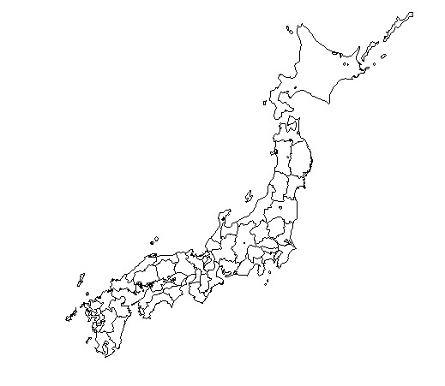
Total 23 Areas are under nomination
at General Sea Area in Japan
As of 31 Dec. 2021
14. Ishikari,Hokkaido
Auction already launched
1.Goto,Nagasaki Pref.
2.Noshiro-city,Akita Pref.
3.Yurihonjo-city,Akita Pref.(North)
4.Yurihonjo-city,Akita Pref.(South)
5.Choshi-city,Chiba Pref.
16.Shimamaki,Hokkaido
15.Gann-u and Minami-Shiribeshi,Hokkaido Pref.
Developers are decided
18.Matsumae,Hokkaido
17.Hiyama,Hokkaido
19.Mutsu bay,Aomori Pref.
11.Aomori Pref.(Japan Sea North)
Promoting Area
6.Happou-cho/Noshiro-city,Akita Pref.
12.Aomori Pref.(Japan Sea South)
Under auction =>
June 2022: bidding close
Dec: 2022 winner will be
announced
6.Happou-cho/Noshiro-city,Akita Pref.
Promising Area
7.Oga Kitakata, Akita-city, Akita Pref.
8.Yusa,Yamagata Pref.
9.Murakami&Tainai-city Niigata Pref.
10.Isumi-city, Chiba Pref.
11.Aomori Pref.(Japan Sea North)
12.Aomori Pref.(Japan Sea South)
13.Enoshima/Saikai-city,Nagasaki Pref.
2.Noshiro-city,Akita Pref.
3.Yurihonjo-city,Akita Pref.(North)
4.Yurihonjo-city,Akita Pref.(South)
New
7.Oga Kitakata, Akita-city, Akita Pref.
20.Kuji-city,Iwate Pref.
●
●
●
●
●
●
●
●
8.Yusa,Yamagata Pref.
9.Murakami/Tainai-city Niigata Pref.
21.Awara-city,Fukui Pref.
Upcoming Area (In preparation)
14.Ishikari,Hokkaido
15.Gann-u and Minami-Shiribeshi, Hokkaido
16.Shimamaki,Hokkaido
17.Hiyama,Hokkaido
18.Matsumae,Hokkaido
19.Mutsu bay,Aomori Pref.
20.Kuji-city,Iwate Pref.
21.Awara-city,Fukui Pref.
22.Hibikinada Kitakyushu,Fukuoka Pref.
23.Karatsu-city,Saga Pref.
5.Choshi,Chiba Pref.
10.Isumi-city, Chiba Pref.
22.Hibikinada Kitakyushu,Fukuoka Pref.
23.Karatsu-city,Saga Pref.
13.Enoshima/Saikai-city,Nagasaki Pref.
1.Goto,Nagasaki Pref.

Slide 14
Development at General Sea Area Round 1 Auction Results by 2021 end
Sea Area | Developer | PPA price | Turbines & Project scale | In operation
Goto, Nagasaki Pref. (Floating type) | Toda Co. Group | 36 JPY/kWh (265 €/MWh) Based on FIT at floating offshore wind | Hitachi 2.1MW x 8 units = 16.8 MW | Within several Years
Noshiro-city, Akita Pref. (Fixed bottom type) | Mitsubishi Co. and C-tech (subsidiary company of Chubu Electric Power Co,) Group | 13. 26 JPY/kWh * (98 €/MWh) | GE Haliade X x 38 units = 478.8 MW | Dec. 2028
Yorihonjo-city, Akita Pref. (Fixed bottom type) |  | 11. 99 JPY/kWh * (88 €/MWh) | GE Haliade X x 65 units = 819 MW | Dec. 2030
Choshi-city, Chiba Pref. (Fixed bottom type) |  | 16. 49 JPY/kWh * (121 €/MWh) | GE Haliade X x 31 units = 390.6 MW | Sep. 2028
Decided by auction. Initial upper set price was 29 JPY/kWh (214 €/MWh).
Note: Japanese 1st onshore wind auction held last autumn.
Its lowest PPA price was 14.98 JPY/kWh (110 €/MWh).

Slide 15
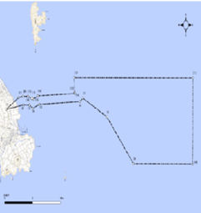
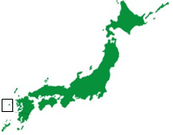
Toda Co. Group won the Nagasaki Goto auction on 11 June. (This is the 1st case at General Common Sea Area in Japan.)
Winner: Toda Co., ENEOS, Osaka Gas,
Kansai Electric, INPEX, Chubu Electric
Note: There were no the other bidders.
Toda has conducted prior MOE’s FOWT
national project at Goto.
Project: Hitachi 2.1MW x 8units = 16.8MW,
on the concrete-steel hybrid spar floaters.
(Initially, Toda intended to add one 5MW.
But, Hitachi stopped its new production.)
Evaluation result:
Price 120/120 +
Business feasibility
87/120
= Total 197/240

Slide 16
Mitsubishi Co. & C Tech group dominated Round 1 auction on 24 Dec. 2021, using Haliade X

Slide 17
3 Areas are selected for “GOJ-led Auction (GOJ ; Government of Japan, Cetrallized auction system may start after 2025)
Gann-u and Minami-Shiribeshi,
Hokkaido Pref.
Hirono-cho,
Iwate Pref.
(For floating
Offshore wind)
Sakata-city,
Yamagata Pref.

Slide 18
Outline of Green Innovation Fund (GI Fund) for Offshore Wind
17
■ GOJ established GI Fund of 2 trillion Yen at NEDO in December, 2020.
■ METI announced in Oct., 2021 that METI has allotted 119.5 bil.JPY (880 mil.€）
to the cost reduction projects for Offshore Wind Power Generation.
■ The cost reduction projects consists of 2 phases.
✔ 1st Phase：Developing Component Technology
(such as Next generation WTG, Floating structure, Advanced O&M etc.)
Period of Subsidy：3 to 5 years (started in October, Y2021)
Total Budget：34.5 billion JPY (254 million €）
✔ 2nd Phase：Testing and Demonstration
(such as Integral design of entire system that combines the WTGs,
floating structures and cables, and verification of cost reduction)
Period of Subsidy：max.8 years (starting Y2023 at earliest)
Total Budget：max. 85 billion JPY (626 million €)
✔ Projects： Projects to be subsidized will be decided through public offering.
＊Next slide is an official document issued by METI in English.

Slide 19
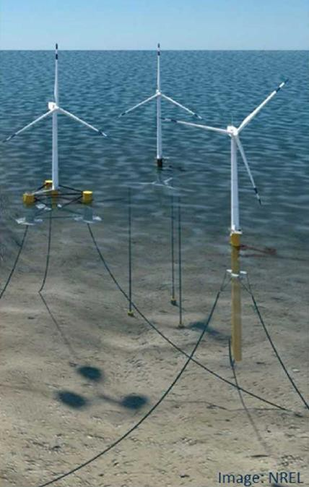
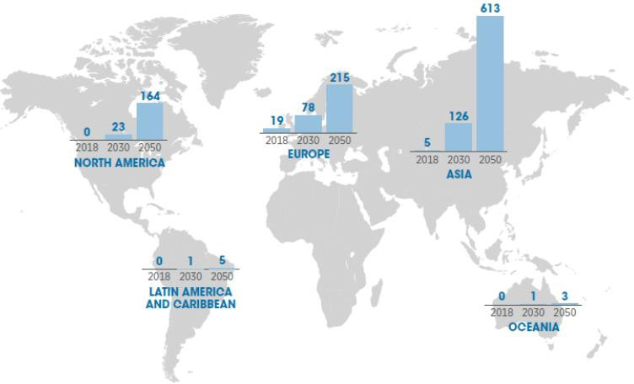
Cost Reductions for Offshore Wind Power Generation (Amount covered by the government: Up to 119.5 billion) yen)
Offshore wind power has been expanding mainly in Europe, but the Asian market is expected to
grow rapidly.
While the introduction of fixed-bottom turbines in shallow waters is progressing, countries are competing to develop technology for floating turbines.
In order to win this competition, the fund will support the following R&D projects for floating turbines
etc.:
Develop technology for wind turbines, floating structures etc. that will be suitable for the meteorological and marine conditions in Asia;
Integrally design an entire system that combines wind turbines, floating structures, cables etc. involving from users (power generation businesses) with a view to achieving internationally competitive cost levels, and demonstrate them toward public implementation.
Forecast for the offshore wind turbine market
(Unit: GW)
Floating offshore wind turbine
Phase 1: Developing component technology
Example challenges:
Reducing costs by using substitutes for steel materials (concrete floats, synthetic fiber mooring)
Wind turbines that are suitable for the natural conditions in Japan and Asia (such as typhoons, earthquakes, lightning strikes, low wind speeds)
Improving the durability of the cables that move along with the floating structures
Failure prediction using AI and big data
Phase 2: Testing
Example challenges:
Integrally designing an entire system that combines the wind turbines, floating structures and cables, and verifying the cost reductions
Source: IRENA "Future of Wind" (October 2019)
R&D goals: Achieve a generation cost of 8 to 9 yen/kWh with seafloor-mounted turbines under certain conditions (wind conditions) by 2030

Slide 20
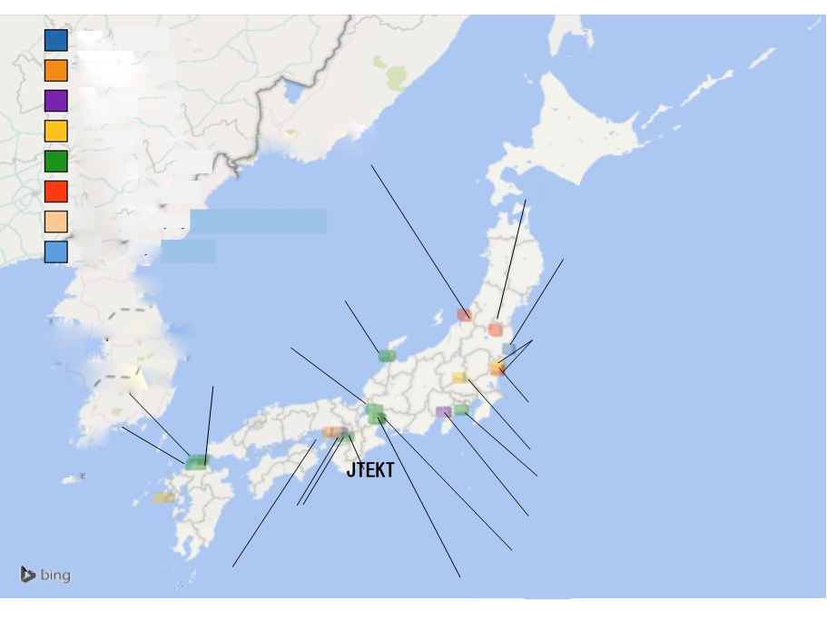
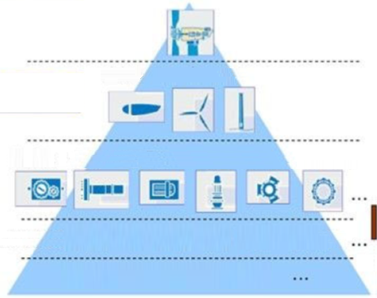
Current Status of Wind Power-related Industries in Japan
20
Although manufacturing bases exist for generators, gearboxes, bearings, etc., appropriate investment is required for offshore wind power.
Japan has the potential for industrial formation thanks to its potential technological capabilities and foundation for manufacturing.
A medium- to long-term introduction target should help promote capital investment in related industries resulting from expectations toward the market formation.
Tower
Nacelle
Blade
Nakajo Plant, Hitachi Industrial Equipment Systems
Nacelle
RotorTower
Generator
Bearings and equipment
(Electrical components)
Electrical components
Kitashiba Electric (Electrical components)
Gearbox
Gearbox
Main shaft
Generator
Yaw bearing
Rotor hub
Rotor bearing
Submarine cable
Aikawa Engineering (Tower)
Hakui Plant, Nippon Roballo (Bearing)
Planetary gears
Spur gear
Casing
Bearing
Slewing ring
Gifu Plant, Nabtesco (Equipment)
Hitachi Works, Hitachi Ltd.
Top board
Ishibashi Manufacturing
OCC submarine system
(Equipment)
(Nacelle, generator)
Omika Works, Hitachi Ltd.
Special steel FRP
Carbon fiber
Nippon Roballo
(Electrical components)
Ohta Sales Office, Meiden Engineering (Generator)
Examples of wind power supply chain
Kyushu Plant
Fujisawa Plant, NSK (Bearing)
Source: Chart II-1, page 5 of “Expectations toward wind power generation from the perspective of industrial promotion—Restoration of the Tohoku area and observations for a review of the energy policies” (Mizuho Industry Focus Vol.99, July 20, 2011)
(Bearing)
Nagasaki Works, Mitsubishi Electric
Komaihaltec
GH Craft (Blade)
(Generator)
(Nacelle)
NTN Mie Corp. (Bearing)
Kobe Works, Mitsubishi Electric (Generator)
Kuwana Works, NTN (Bearing)
Distribution of domestic wind power-related industries
Source: “JWEA's views and directions regarding the domestic wind industry (industrial aspects)”
Quoted from the presentation of Takashi Matsunobu at the Japan Wind Energy Association, the 41st Symposium on Wind Power Energy Utilization, December 4, 2019)

Slide 21
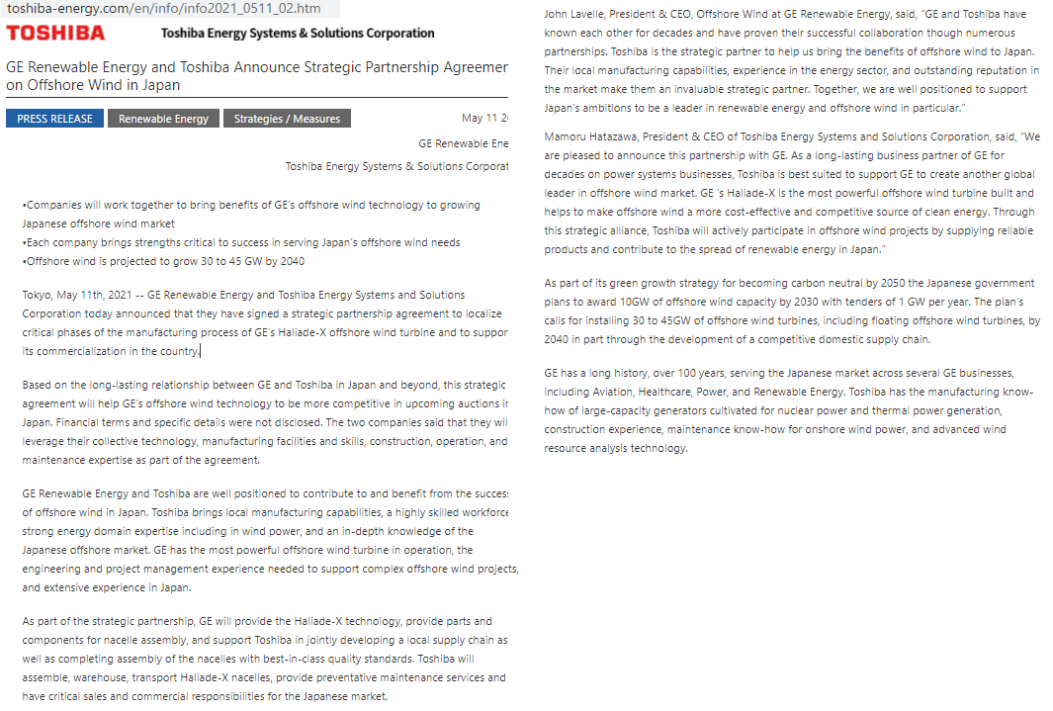
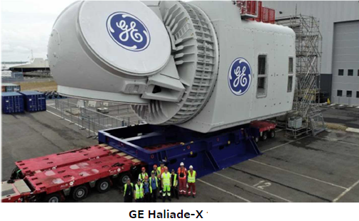
Toshiba is to start Haliade X nacelle assembly in Yokohama factory.

Slide 22
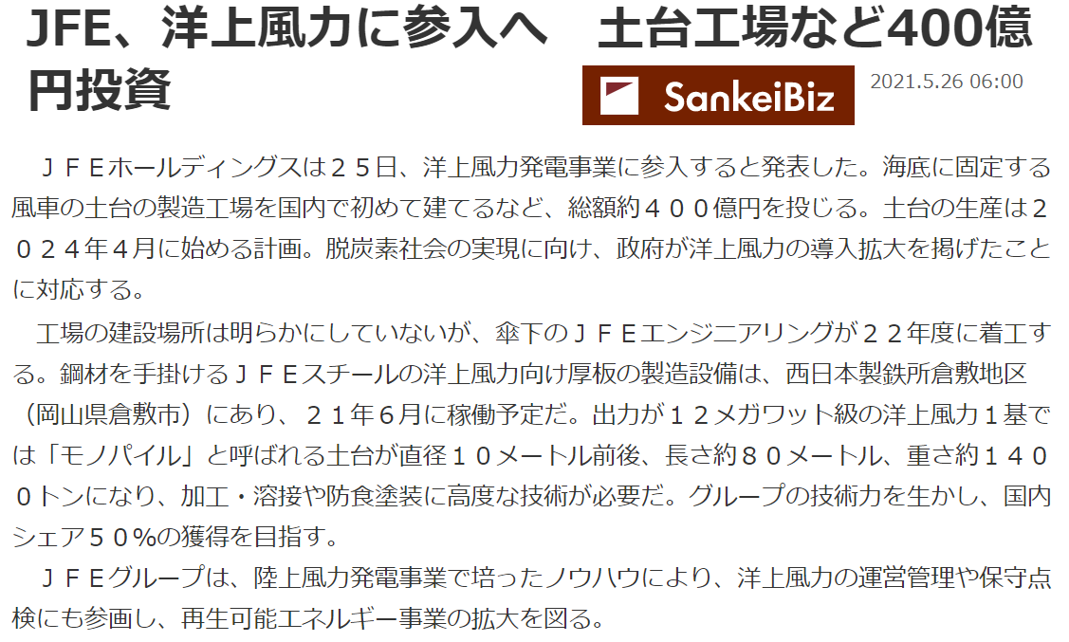
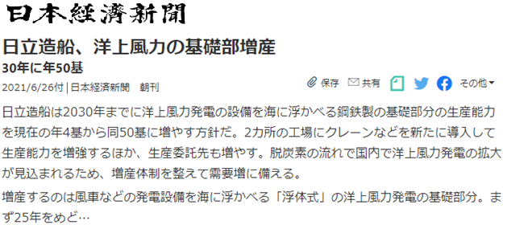
Japanese news article for JFE & Hitz
JFE Steel invests 40 billion JPY
(295 million €) .
To open Monopile foundation factory at Kurashiki in Okayama Pref. and
To open Transition Piece factory
at Tsu in Mie Pref..
Hitz increases semi-sub type
Floater production ability from
4 units to 50 units per year.

Slide 23
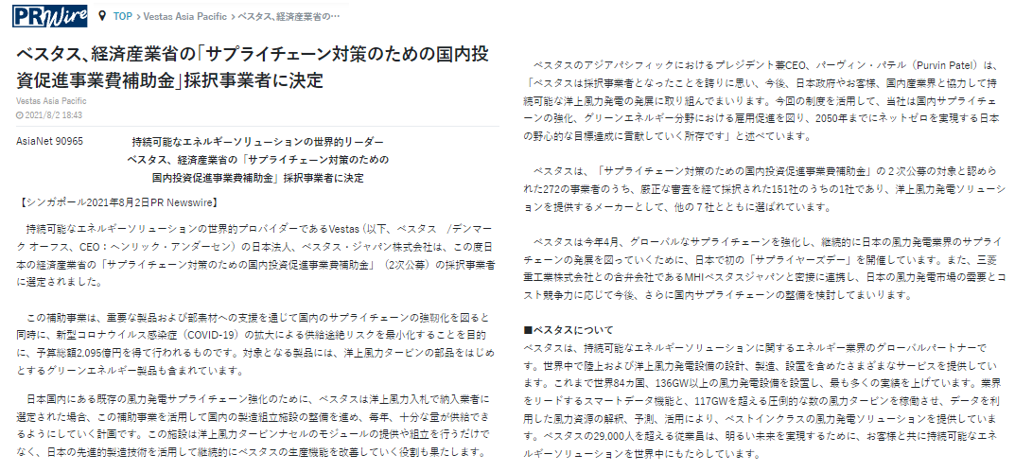
As for “Raising up Domestic Supply Chain”, Vestas announced to get subsidy from Japanese METI on 2 Aug, 2021. https://kyodonewsprwire.jp/release/20210802844
Vestas may open factory in Japan
(may be in Nagasaki).

Slide 24
Why you need Japanese partners ?
Japanese market is “unique”.
General
- Weather & terrains are different from Europe.
(Typhoon, Earthquake, Tsunami, etc.)
For manufacturers
- Permissions, Local regulations & standards(JIS), etc.
(Very difficult and complicated. )
For developers
- Action permission needs “Local resident agreement”.
(Local people won’t accept explanation “in English”.)
=> “Render unto Japan the things which are Japanese.”
To have a partnership with skilled Japanese companies
is the good way to achieve the success in Japan.

Slide 25
Partnership of Japanese & Foreign companies
Green：design,manufacturing,construction, black：worldwide, red：domestic (Japan)
Date | Japanese side | Foreign side | Pａｒｔｎｅｒｓｈｉｐ ｆｉｅｌｄ
Nov. 2012 | Hitz | Equinor(Ｎｏｒｗｅｙ） | Ｆｌｏａｔｉｎｇ ｏｆｆｓｈｏｒｅ ｗｉｎｄ
Jan．2014 | MHI | Vestas（Denmark） | MVOW
Mar. 2015 | Hits | IDEOL(France) | Ｆｌｏａｔｉｎｇ ｏｆｆｓｈｏｒｅ ｗｉｎｄ
Nov. 2015 | Mitsubishi, Chiyoda | Principle Power（USA) | WindFloat Atlantic
2016 | SatoTekko | Sif（Netherland） | Monopile foundation
Aug. 2018 | Idemitsu | Equinor(Norway) | Hywind Tampen
Sep. 2018 | J Power | ENGIE（France） | Floating offshore wind
Dec. 2018 | JERA | Macquarie（Australia） Swancore（Taiwan） | Formosa1（128MW）, in Taiwan
Jan. 2019 | TEPCO | Orsted（Denmark） | Choshi project
Apr. 2019 | Kyushu Elec. | E.ON（Germany） | Fixed bottom offshore wind
2019 | Shimoda Iron Works | Euskal Forging(Spain) | Flange for monoplle foundation
Oct. 2019 | Taisei | IDEOL(France) | Floating offshore wind
May. 2020 | Tokyo Gas | Principle Power（USA） | Floating offshore wind
Jun. 2020 | JERA | IDEOL（France）, ADEME(France） | Floating offshore wind in UK and France
Jul. 2020 | MHI | CIP（Denmark） | Offshore wind in Hokkaido
Sep. 2020 | Acaia Renewables | Iberdrola(Spain) | Offshore wind in Japan
Nov. 2020 | Nihon Yusen | Fugro(Netherland) | Seabed research Vessel
Apr. 2021 | Penta Ocean | DEME(Belgium) | Construction JV
May 2021 | Toshiba | GE(USA) | Offshore WTG nacelle assemble in Japan
Jan 2022 | NYK | Van Oord(Netherland) | Offshore wind transport
Feb. 2022 | Kajima | Van Oord(Netherland) | Construction

Slide 26
The Japan Wind Power Association (JWPA)
22
■ Brief History
Dec. 17, 2001： Established as a voluntary organization
May. 27, 2009： Registered as a General Incorporated Association
■ Composition of Members (as of 22 Mar., 2022)
✔ Number of members：525 companies and corporations
✔ Our members own and operate approx.85%
of the wind farms in Japan.
■ Board Members
✔ JWPA board is managed by 20 directors and 2 auditors
✔ Those members constitute of developers, manufacturers,
general contractors, law firms, financial institutions, etc.

Slide 27
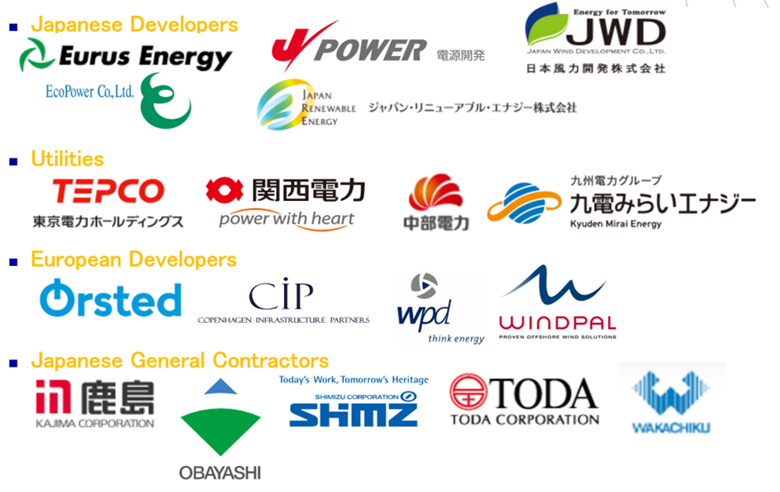
Core Members of JWPA
23

Slide 28
28
Offshore wind power
in Japan is promising.
Please get the chance.
Thank you for your attention！

Slide 29
Offshore Wind Power Development - Business Matching in Japan -
For WindEurope 2022 at Bilbao,
April 2022
Mr. Yoshinori UEDA
General Manager, Communication
Japan Wind Power Association (JWPA)
Wind Power Kamisu, in Ibaraki pref.
2MW x 15units = 30MW,
Starts operation in 2010&2013.

Slide 30
Business Matching for Offshore Wind Power Development in Japan
Needs:
- “Offshore Wind” is a new business & a new industry for Japan.
Japanese companies have good skill & ability, but, no experience.
Therefore, they needs skilled good foreign partners as teachers.
- Oversea companies aim Japanese market, but, lacking connection,
Major Business Channel:
- Embassies, Chambers of commerce and Wind power associations
of Denmark, Germany, UK, Spain, Netherland, Norway, etc..
Tactics / Method:
- Delegations, Conferences, Seminars & Webinars, and
Business matching meetings

Slide 31
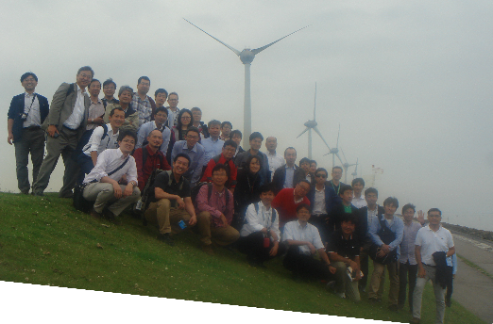
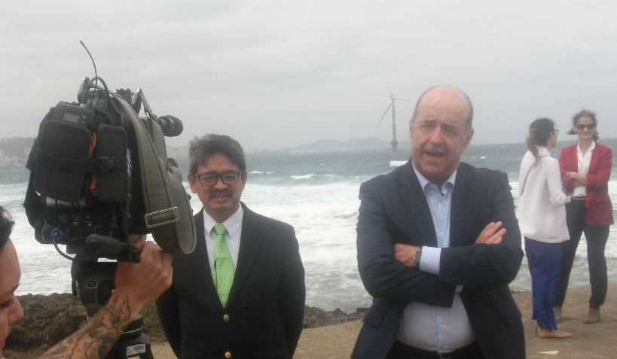
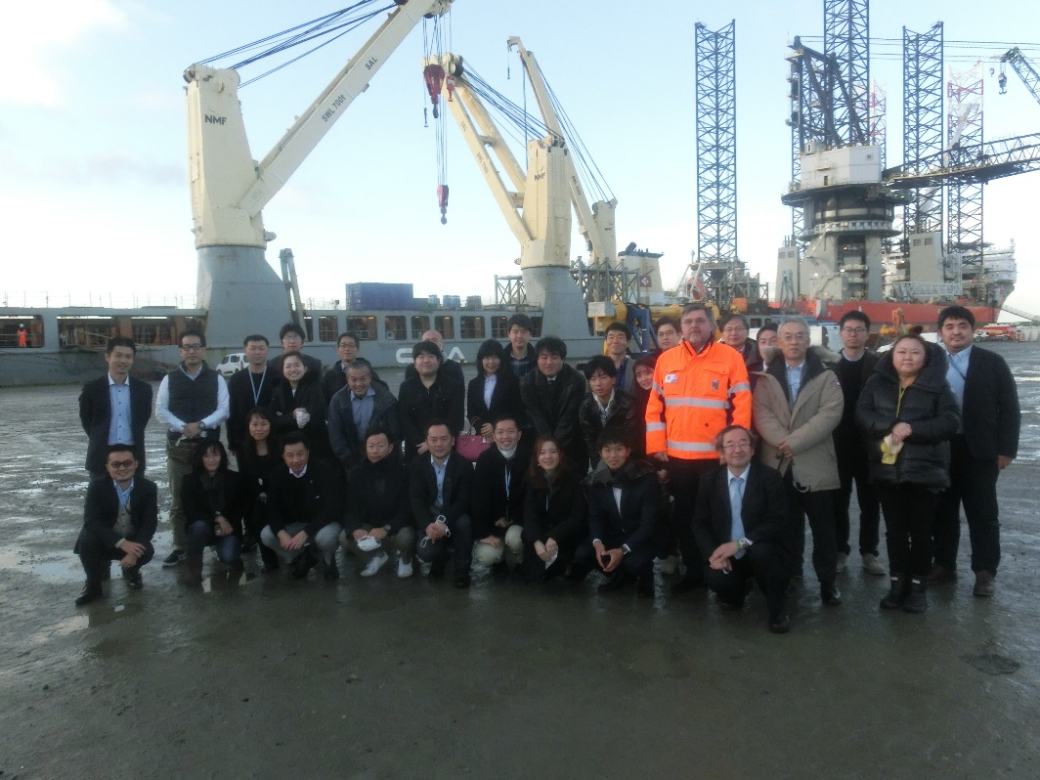
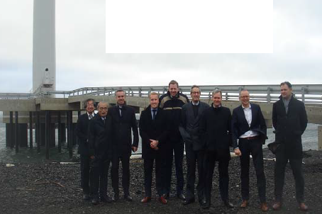
Delegations (Since 2015)
Japan=>Netherland, in 2015
Japan=>Spain, in 2018
Japan=>Denmark, in 2021
Netherland=>Japan
in 2015

Slide 32
Delegations from Japan (2015 ‐ 2022）
Past experience
2015 Netherland
2016 Netherland
2017 Denmark（twice）
2018 Spain
2019 U.K.. Taiwan(twice)
2021 Denmark
Plan in 2022
April, Spain(Bilbao)
June, U.K.(Aberdeen. Etc.)
Sep., Germany(Hamburg, etc.)

Slide 33
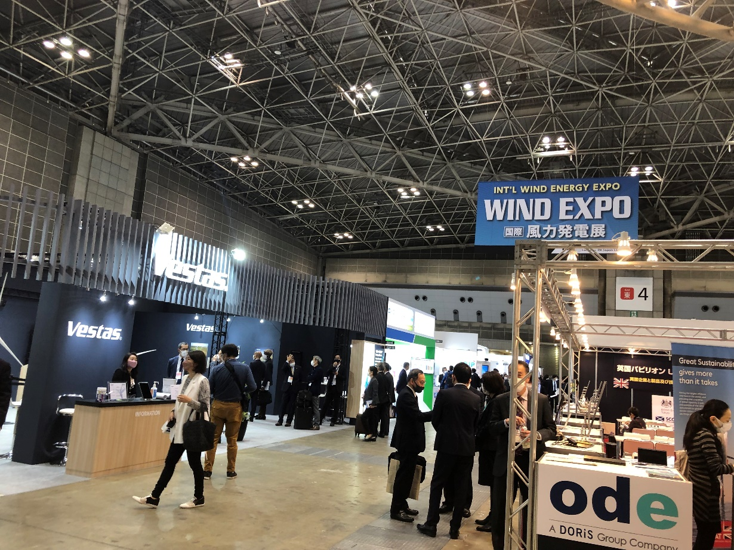
Conferences & Exhibitions (since 2013)
WindExpo2022 Spring
since 2013
by Reed Exhibition Japan & JWPA
Global Offshore Wind Summit Japan
(GOWSJ), since 2021
by GWEC & JWPA
Plan in 2022
- WindExpo 2022 Autumn,
on 31 Aug.-2 Sep,, at Tokyo
- GOWS-J 2022,
on 9.10 Nov., at Akita city
Please visit Japan and get
the business mating chance..

Slide 34
Seminars / Webinars, Business Matching (frequently since 2017)
Embassies, Japanese Government (METI, etc.) hold several 10s of offshore wind seminars annually.
Online Offshore wind seminars in March 2022 ;
3 Thu. by UK Emb. (Scotland)
9 Wed. by UK Emb. For UK companies
10 Thu. by German Offshore Initiative(GOI)
14&15 Mon.&Tue. by UK Emb.（England）
15 Tue. by Netherland Emb.
17 Thu. by Japanese METI/ANRE
25 Fri. by Japanese MOFA

Slide 35
Why you need Japanese partners ?
Japanese market is “unique”.
General
- Weather & terrains are different from Europe.
(Typhoon, Earthquake, Tsunami, etc.)
For manufacturers
- Permissions, Local regulations & standards(JIS), etc.
(Very difficult and complicated. )
For developers
- Action permission needs “Local resident agreement”.
(Local people won’t accept explanation “in English”.)
=> “Render unto Japan the things which are Japanese.”
To have a partnership with skilled Japanese companies
is the good way to achieve the success in Japan.

Slide 36
Partnership of Japanese & Foreign companies
Green：design,manufacturing,construction, black：worldwide, red：domestic (Japan)
Date | Japanese side | Foreign side | Pａｒｔｎｅｒｓｈｉｐ ｆｉｅｌｄ
Nov. 2012 | Hitz | Equinor(Ｎｏｒｗｅｙ） | Ｆｌｏａｔｉｎｇ ｏｆｆｓｈｏｒｅ ｗｉｎｄ
Jan．2014 | MHI | Vestas（Denmark） | MVOW
Mar. 2015 | Hits | IDEOL(France) | Ｆｌｏａｔｉｎｇ ｏｆｆｓｈｏｒｅ ｗｉｎｄ
Nov. 2015 | Mitsubishi, Chiyoda | Principle Power（USA) | WindFloat Atlantic
2016 | SatoTekko | Sif（Netherland） | Monopile foundation
Aug. 2018 | Idemitsu | Equinor(Norway) | Hywind Tampen
Sep. 2018 | J Power | ENGIE（France） | Floating offshore wind
Dec. 2018 | JERA | Macquarie（Australia） Swancore（Taiwan） | Formosa1（128MW）, in Taiwan
Jan. 2019 | TEPCO | Orsted（Denmark） | Choshi project
Apr. 2019 | Kyushu Elec. | E.ON（Germany） | Fixed bottom offshore wind
2019 | Shimoda Iron Works | Euskal Forging(Spain) | Flange for monoplle foundation
Oct. 2019 | Taisei | IDEOL(France) | Floating offshore wind
May. 2020 | Tokyo Gas | Principle Power（USA） | Floating offshore wind
Jun. 2020 | JERA | IDEOL（France）, ADEME(France） | Floating offshore wind in UK and France
Jul. 2020 | MHI | CIP（Denmark） | Offshore wind in Hokkaido
Sep. 2020 | Acaia Renewables | Iberdrola(Spain) | Offshore wind in Japan
Nov. 2020 | Nihon Yusen | Fugro(Netherland) | Seabed research Vessel
Apr. 2021 | Penta Ocean | DEME(Belgium) | Construction JV
May 2021 | Toshiba | GE(USA) | Offshore WTG nacelle assemble in Japan
Jan 2022 | NYK | Van Oord(Netherland) | Offshore wind transport
Feb. 2022 | Kajima | Van Oord(Netherland) | Construction

Slide 37
Mitsubishi Co. & C Tech group dominated Round 1 auction on 24 Dec. 2021, using Haliade X
It looks like that Japanese domestic developers dominated Round 1 auction on 24 Dec.2021.

Slide 38
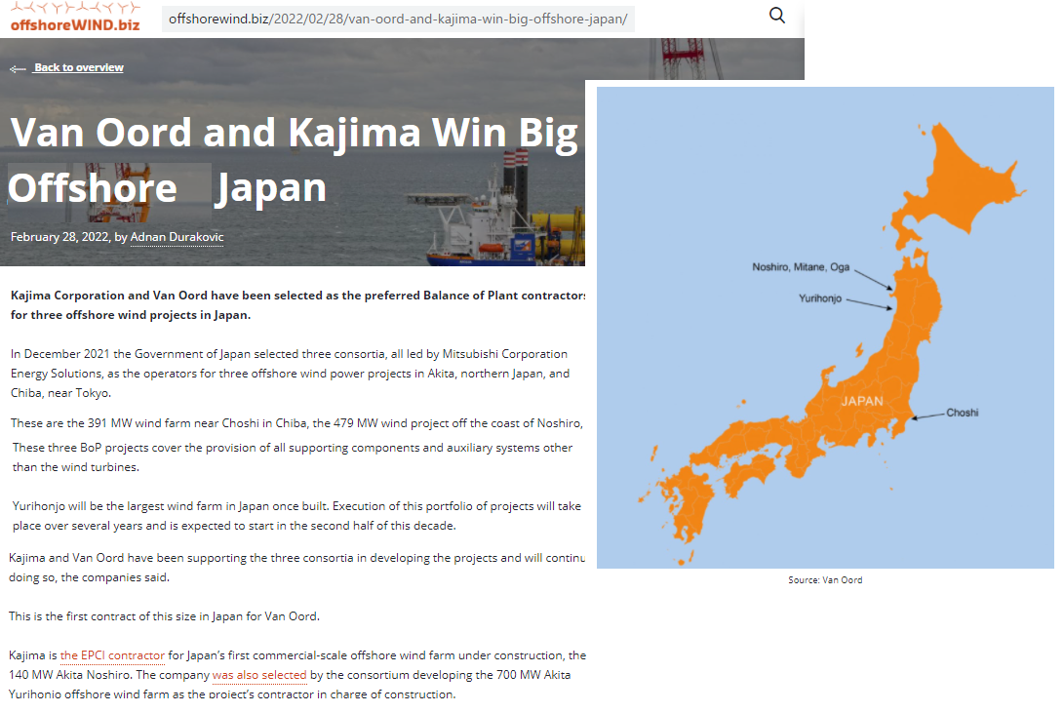
Kajima Co. partner with Van Oord
But, Holland Van Oord got construction work with Japanese Kajima at Round1 auction.

Slide 39
Toshiba is to start Haliade X nacelle assembly in Yokohama factory.
GE got Round1 order and their Haliade X
are to be assembled by Japanese Toshiba.
International cooperation is the key to get work in Japanese offshore wind.

Slide 40
The Japan Wind Power Association (JWPA)
22
■ Brief History
Dec. 17, 2001： Established as a voluntary organization
May. 27, 2009： Registered as a General Incorporated Association
■ Composition of Members (as of 22 Mar., 2022)
✔ Number of members：525 companies and corporations
✔ Our members own and operate approx.85%
of the wind farms in Japan.
■ Board Members
✔ JWPA board is managed by 20 directors and 2 auditors
✔ Those members constitute of developers, manufacturers,
general contractors, law firms, financial institutions, etc.

Slide 41
Core Members of JWPA
23

Slide 42
42
Offshore wind power
in Japan is promising.
Please get the chance.
Thank you for your attention！

